Slide 1
Domain-Specific Corpora

Slide 2
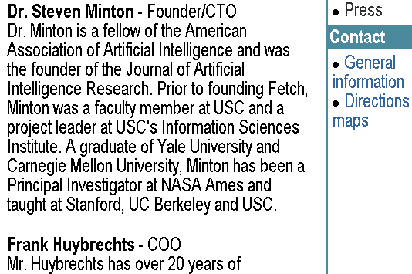
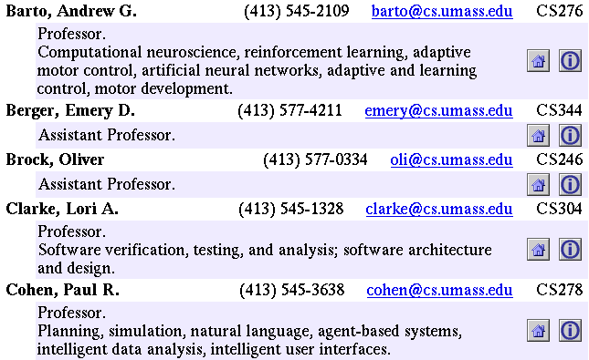
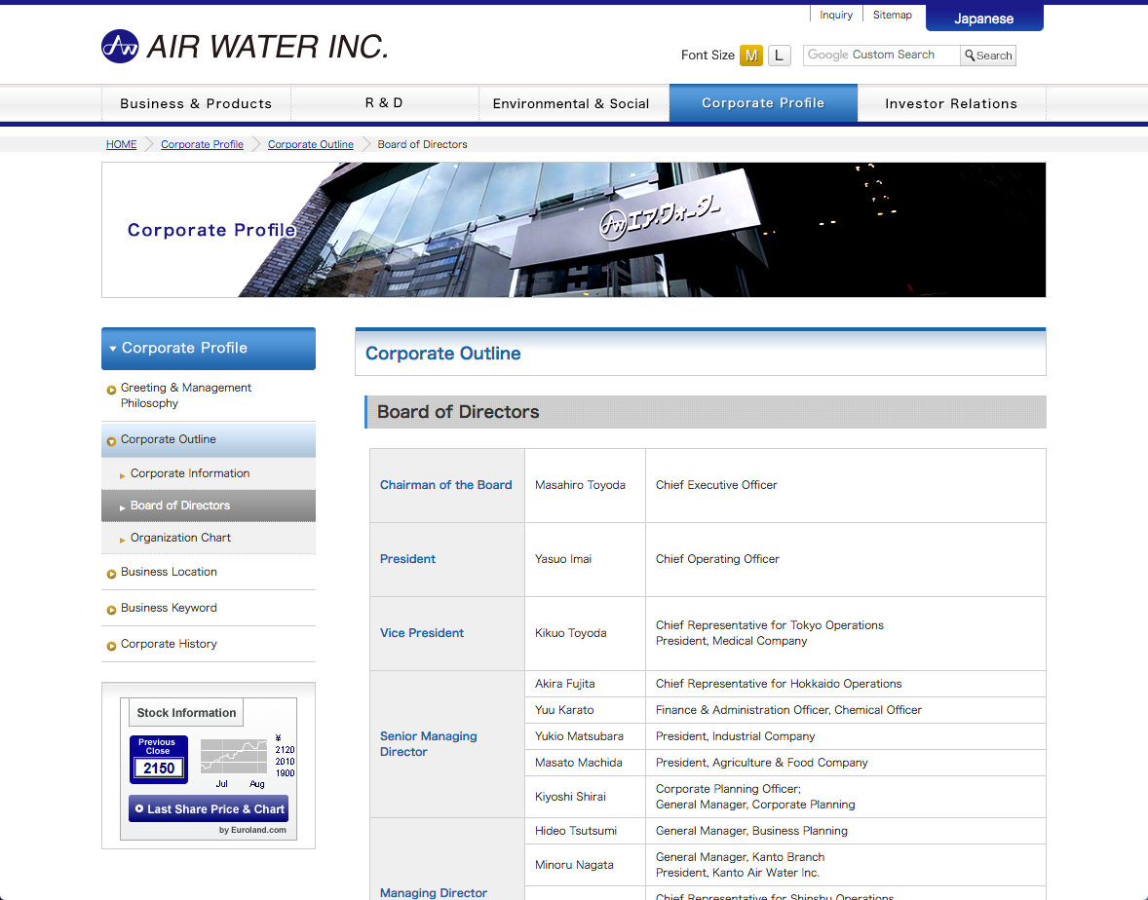
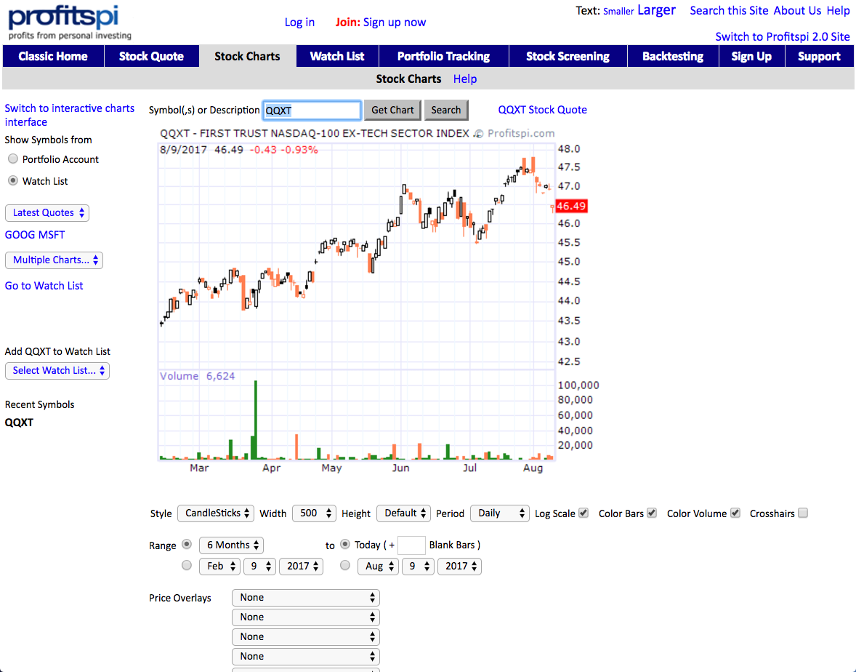
Many Document Features
Text paragraphs
without formatting
Astro Teller is the CEO and co-founder of BodyMedia. Astro holds a Ph.D. in Artificial Intelligence from Carnegie Mellon University, where he was inducted as a national Hertz fellow. His M.S. in symbolic and heuristic computation and B.S. in computer science are from Stanford University. His work in science, literature and business has appeared in international media from the New York Times to CNN to NPR.
Grammatical sentences plus some formatting & links
Non-grammatical snippets, rich formatting & links
Tables
Charts

Slide 3
Pattern Complexity
Closed set
Regular set
U.S. states
U.S. phone numbers
He was born in Alabama…
Phone: (413) 545-1323
The big Wyoming sky…
The CALD main office can be reached at 412-268-1299
Complex
Ambiguous, needing context
Unusual language models
U.S. postal addresses
Person names
University of Arkansas
P.O. Box 140
Hope, AR 71802
…was among the six houses sold by Hope Feldman that year.
“YOU don't wanna miss out on ME :) Perfect lil booty Green eyes Long curly black hair Im a Irish, Armenian and Filipino mixed princess :) ❤ Kim ❤ 7○7~7two7~7four77 ❤ HH 80 roses ❤ Hour 120 roses ❤ 15 mins 60 roses”
Pawel Opalinski, Software Engineer at WhizBang Labs.
Headquarters:
1128 Main Street, 4th Floor
Cincinnati, Ohio 45210
Courtesy of Andrew McCallum
Notes:
How complicated a modeling technique will you have to use?

Slide 4
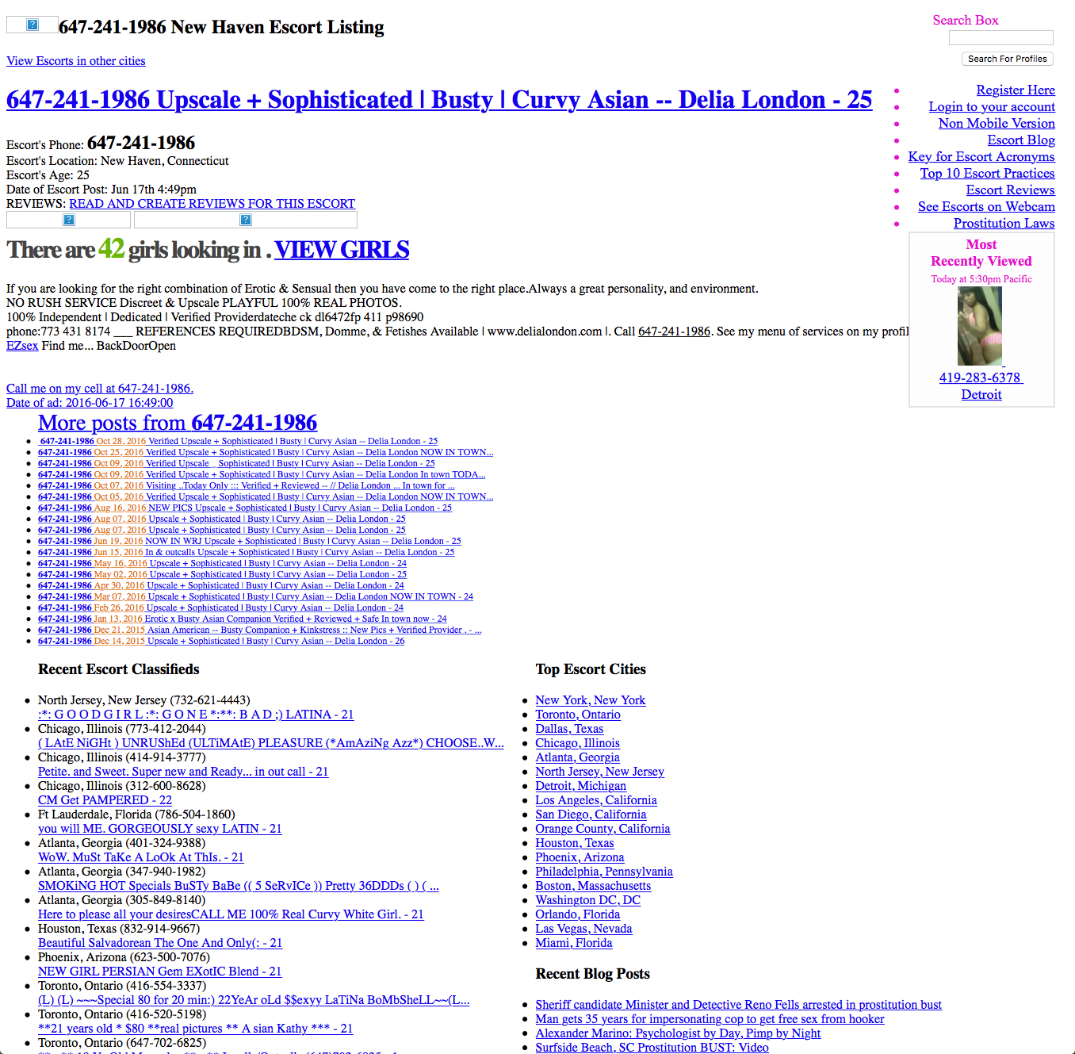
small amount of relevant content irrelevant content very similar to relevant content

Slide 5
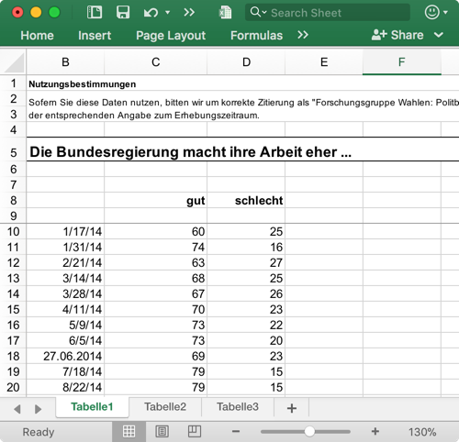
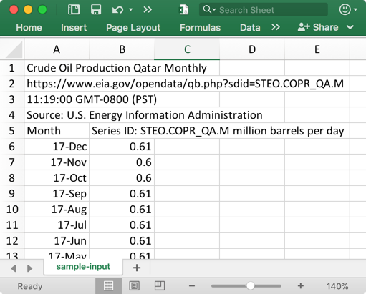
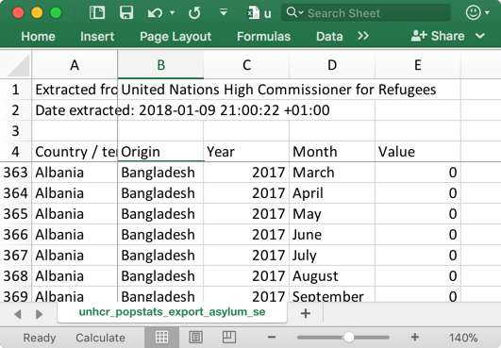
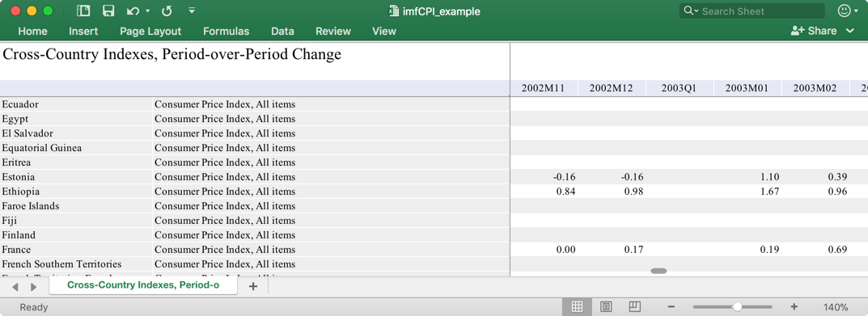
Spreadsheets Created For Human Consumption

Slide 6
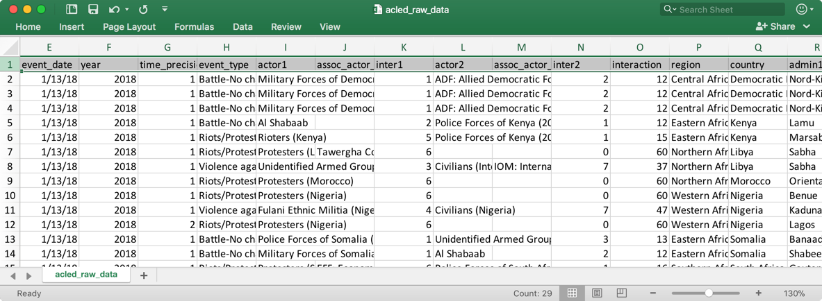
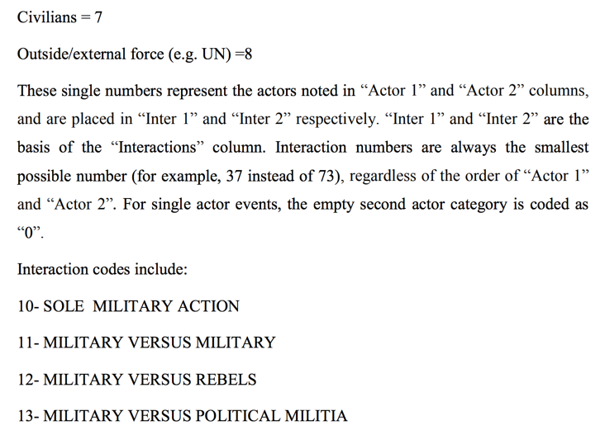
Databases with PDF Code Books
PDF

Slide 7
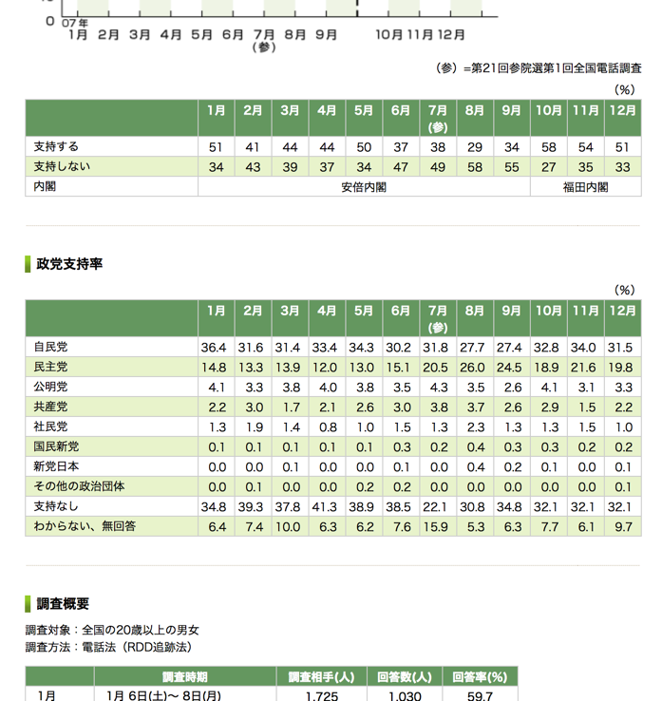
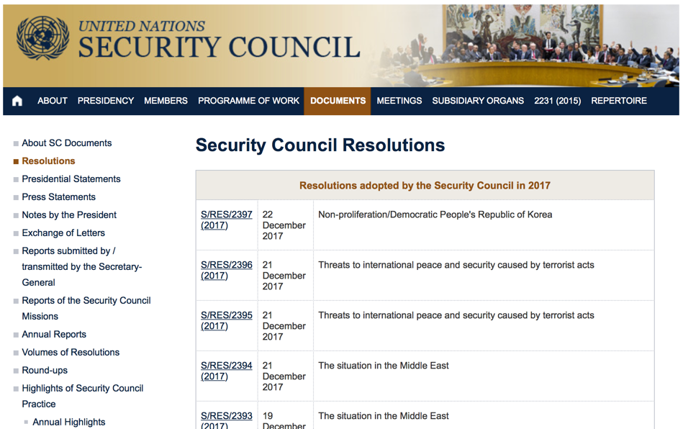
Data In Web Tables

Slide 8
Practical Considerations
How good (precision/recall) is necessary?
High precision when showing KG nodes to users
High recall when used for ranking results
How long does it take to construct?
Minutes, hours, days, months
What expertise do I need?
None (domain expertise), patience (annotation), scripting, machine learning guru
What tools can I use?
Many …

Slide 9
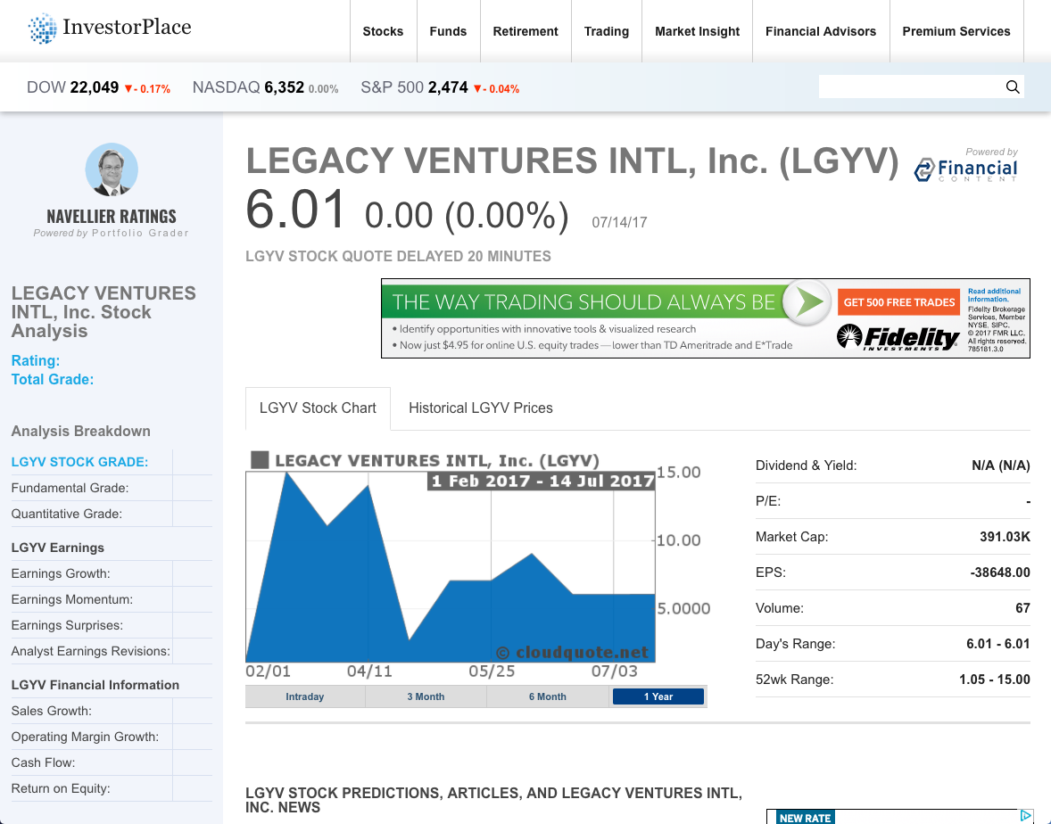
Information Extraction Process
Segmentation
Data Extraction

Slide 10
Information Extraction Process
Segmentation
Data Extraction

Slide 11
Information Extraction Process
Segmentation
Data Extraction
Name:
Legacy Ventures Intl, Inc.
Stock:
LGYV
Date:
2017-07-14
Market Cap:
391,030

Slide 12
Segmentation

Slide 13
Segmentation
Homogeneous blocks

Slide 14
Segmentation
Block Type | Tool
Repeating blocks (short tail) | Web wrappers
Tables (long tail) | Data table extractors
Main content (long tail) | https://code.google.com/archive/p/arc90labs-readability/ https://github.com/kohlschutter/boilerpipe
Microdata (long tail) | https://github.com/namsral/microdata

Slide 15

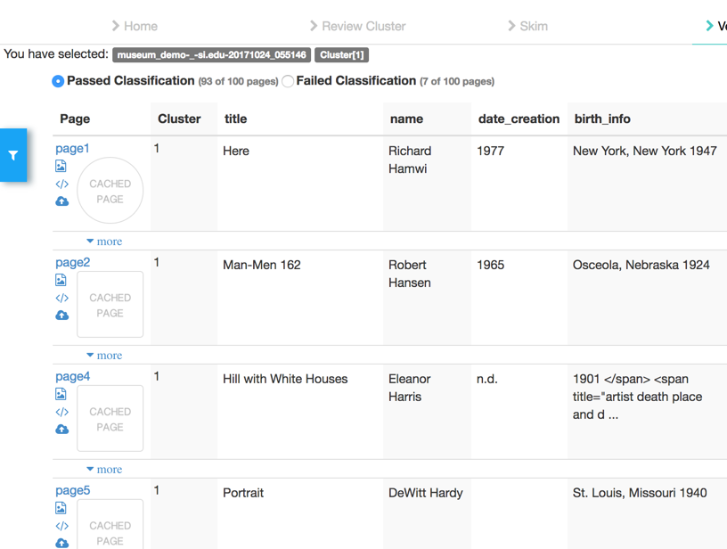
Web Wrappers

Slide 16
myDIG Demo
Focusing On Inferlink Web Wrapper

Slide 17
Table Extraction

Slide 18
Classification Of Web Tables
Table type | % total | count
“Tiny” tables | 88.06 | 12.34B
HTML forms | 1.34 | 187.37M
Calendars | 0.04 | 5.50M
Filtered Non-relational, total | 89.44 | 12.53B
Other non-rel (est.) | 9.46 | 1.33B
Relational (est.) | 1.10 | 154.15M
Cafarella’08
Notes:
Cafarella’08: WebTables: Exploring the Power of Tables on the Web

Slide 19
Tables In The Human Trafficking Domain
number of rows
number of columns

Slide 20
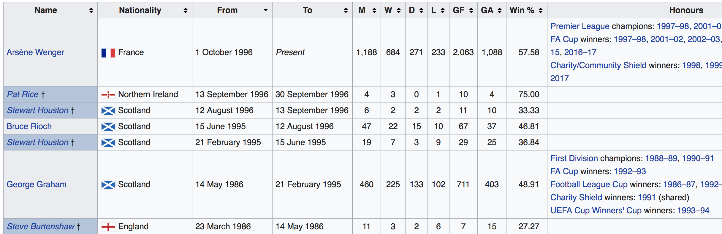
Data Tables
Relational

Slide 21
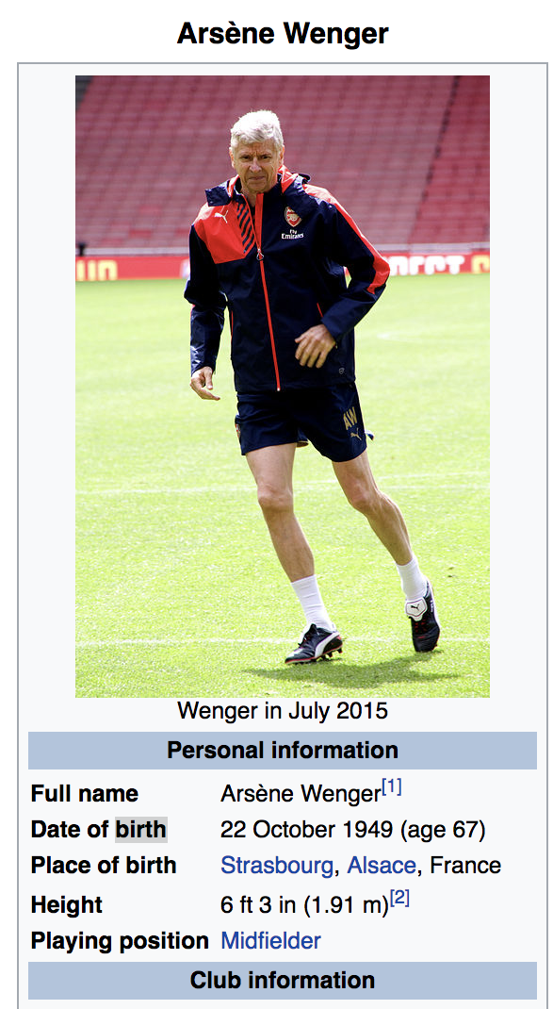
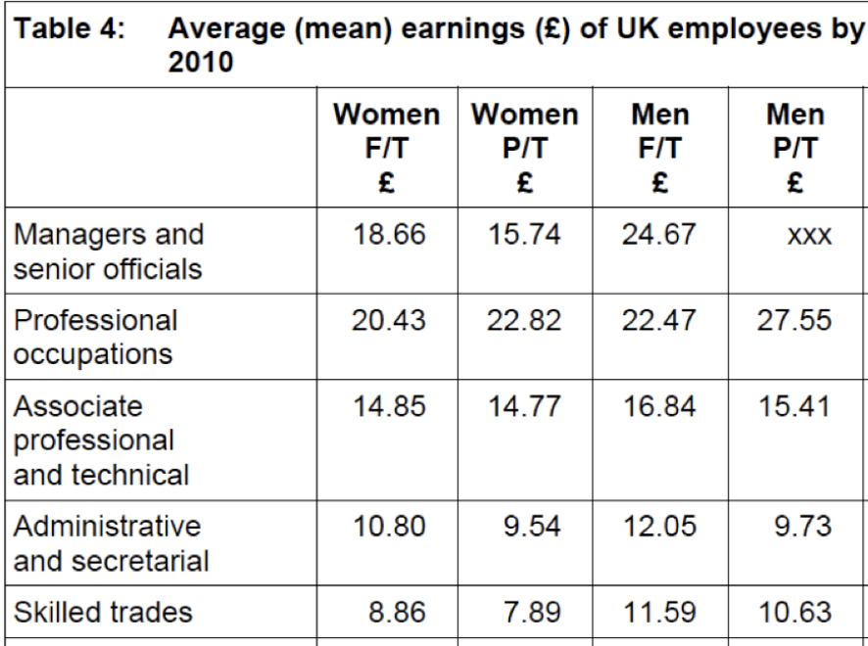
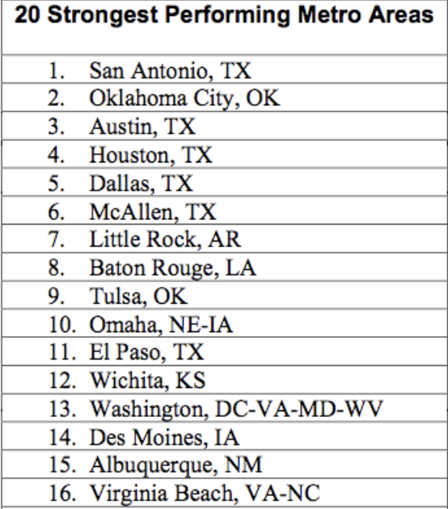
Data Tables
Matrix Table
List Table
Entity Table

Slide 22
Table Type Classification
Feature-based supervised classification
Cafarella’08
Crestan’11
Eberius’15
Deep Learning
Nishida’2017

Slide 23
Identifying Data Tables
Heuristic
HTML tables that don’t contain nested tables
and contain at least 2 rows and 2 columns

Slide 24
Extracting Data From Tables
Co-embedding table structure and content words

Slide 25
Data Extraction

Slide 26
Data Extraction Techniques
Glossary
Regular expressions
Natural language rules
Named entity recognition
Sequence labeling (Conditional Random Fields)

Slide 27
Glossary Extraction

Slide 28
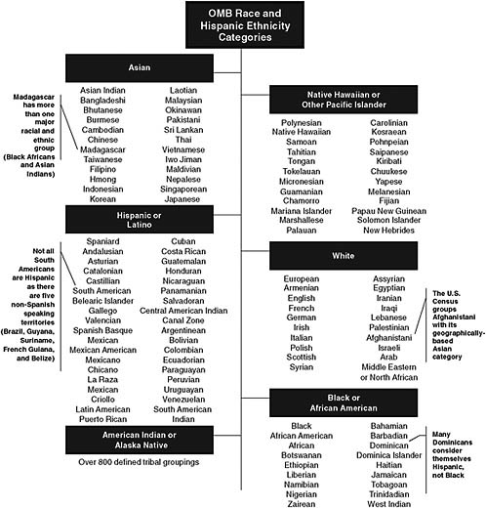
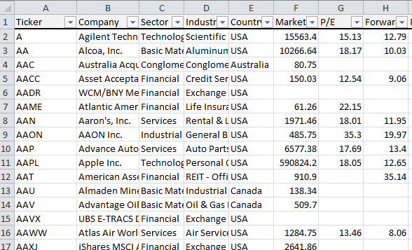

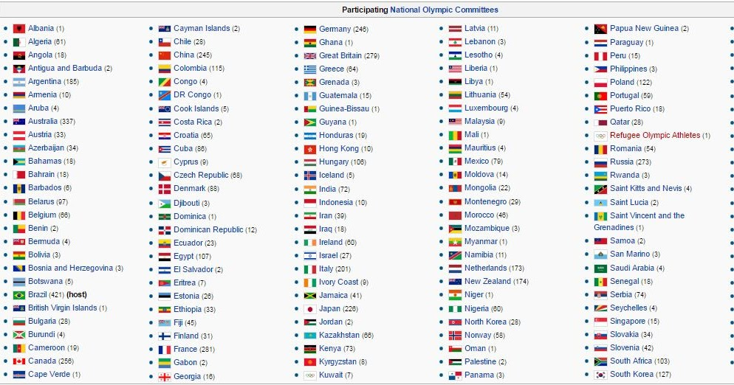
Glossaries
Ethnicities
Stock ticker symbols
Countries
Organizations

Slide 29
Glossary Extraction
Simple
list of words or phrases to extract
Challenges
Ambiguity: Charlotte is a name of a person and a city
Colloquial expressions: “Asia Broadband, Inc.” vs “Asia Broadband”
Research
Improving precision of glossary extractions using context
Creating/extending glossaries automatically

Slide 30
Regex Extraction

Slide 31
Extraction Using Regular Expressions
Too difficult for non-programmers
regex for North American phone numbers:
^(?:(?:\+?1\s*(?:[.-]\s*)?)?(?:\(\s*([2-9]1[02-9]|[2-9][02-8]1|[2-9][02-8][02-9])\s*\)|([2-9]1[02-9]|[2-9][02-8]1|[2-9][02-8][02-9]))\s*(?:[.-]\s*)?)?([2-9]1[02-9]|[2-9][02-9]1|[2-9][02-9]{2})\s*(?:[.-]\s*)?([0-9]{4})(?:\s*(?:#|x\.?|ext\.?|extension)\s*(\d+))?$
Brittle and difficult to adapt to specific domains
unusual nomenclature and short-hands
obfuscation

Slide 32
NLP Rule-Based Extraction

Slide 33
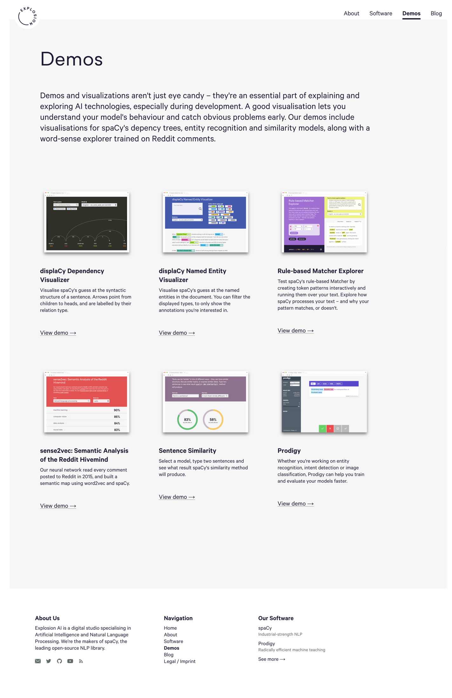
spaCy: https://explosion.ai/demos/
Kejriwal, Szekely

Slide 34
NLP Rule-Based Extraction
Tokenization
Pattern Matching

Slide 35
Tokenization matters, a lot
My name is Pedro
My
name
is
Pedro
310-822-1511
310-822-1511
310
-
822
-
1511
Candy
is here
Candy
is
here
Candy
is
here

Slide 36
Token Properties
Surface properties
Literal, type, shape, capitalization, length, prefix, suffix, minimum, maximum
Language properties
Part of speech tag, lemma, dependency

Slide 37
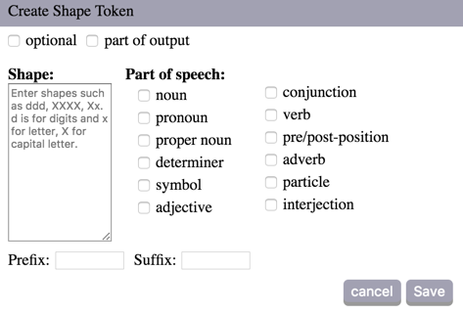
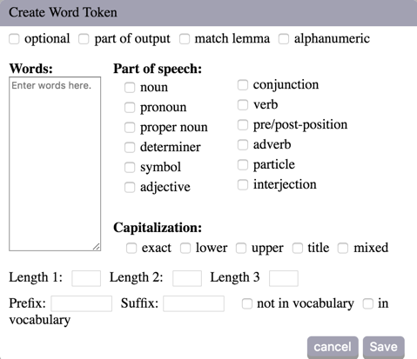
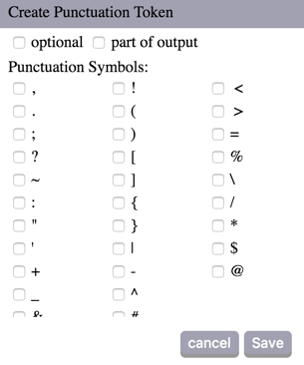
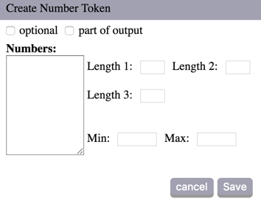
Token Types

Slide 38
Patterns
Pattern := Token-Spec
[Token-Spec]
Token-Spec +
Token-Spec Pattern
Optional
One or more

Slide 39
Positive/Negative Patterns
General
Specific
Positive
Generate candidates
Negative
Remove candidates
Output overlaps positive candidates

Slide 40
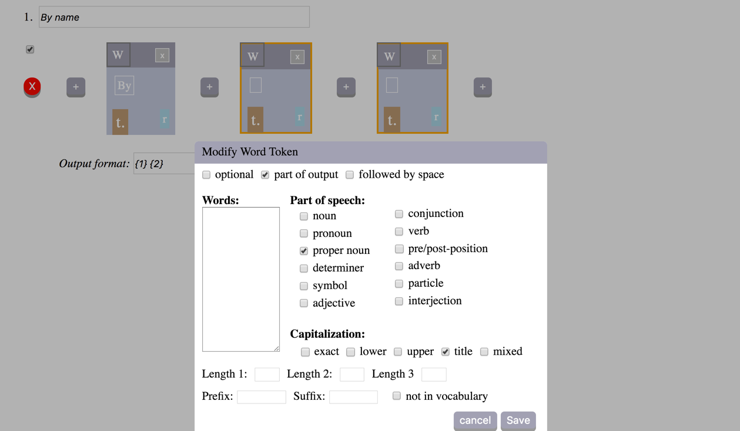
DIG Demo
Kejriwal, Szekely

Slide 41
NLP Rule-Based Extraction
Advantages
Easy to define
High precision
Recall increases with number of rules
Disadvantages
Text must follow strict patterns

Slide 42
Named-Entity Recognizers

Slide 43
Named Entity Recognizers
Machine learning models
people, places, organizations and a few others
SpaCy
complete NLP toolkit, Python (Cython), MIT license
code: https://github.com/explosion/spaCy
demo: http://textanalysisonline.com/spacy-named-entity-recognition-ner
Stanford NER
part of Stanford’s NLP software library, Java, GNU license
code: https://nlp.stanford.edu/software/CRF-NER.shtml
demo: http://nlp.stanford.edu:8080/ner/process
Kejriwal, Szekely

Slide 44
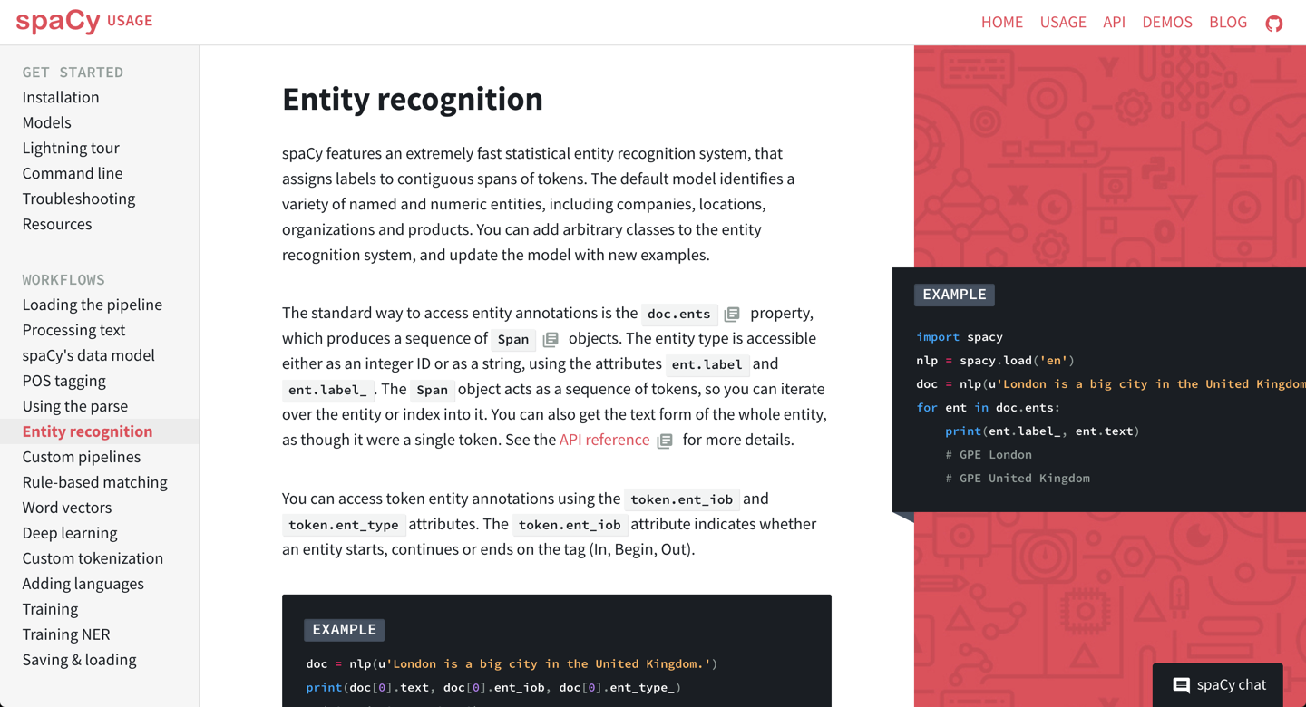
https://spacy.io/docs/usage/entity-recognition
Kejriwal, Szekely

Slide 45
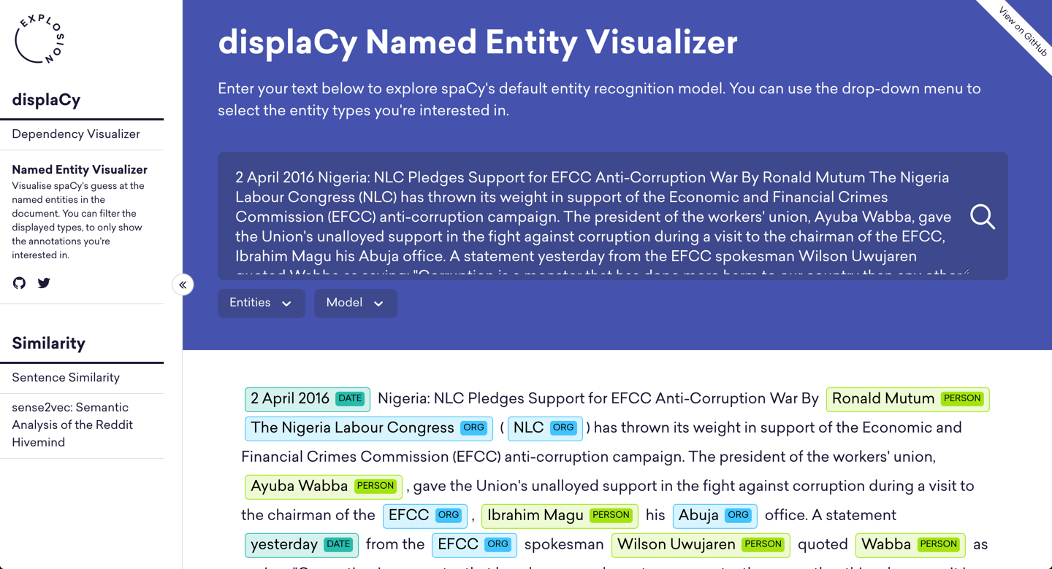
https://demos.explosion.ai/displacy-ent
Kejriwal, Szekely

Slide 46
Named Entity Recognizers
Advantages
Easy to use
Tolerant of some noise
Easy to train
Disadvantages
Performance degrades rapidly for new genres, language models
Requires hundreds to thousands of training examples

Slide 47
Conditional Random Fields

Slide 48
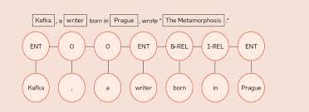
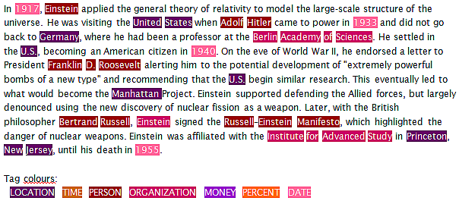
Conditional Random Fields (CRF)
Good for fields that have regular text structure/context

Slide 49
Modeling Problems With CRF
i | X1 (word) | X2 (capitalized) | X3 (POS Tag) | Y (entity)
1 | My | 1 | Possessive Pron | Other
2 | name | 0 | Noun | Other
3 | is | 0 | Verb | Other
4 | Pedro | 1 | Proper Noun | Person-Name
5 | Szekely | 1 | Proper Noun | Person-Name
Other common features:
lemma, prefix, suffix, length

Slide 50
CRF Advantages/Disadvantages
Advantages
Expressive
Tolerant of noise
Stood test of time
Software packages available
Disadvantages
Requires feature engineering
Requires thousands of training examples

Slide 51
Open Information Extraction

Slide 52
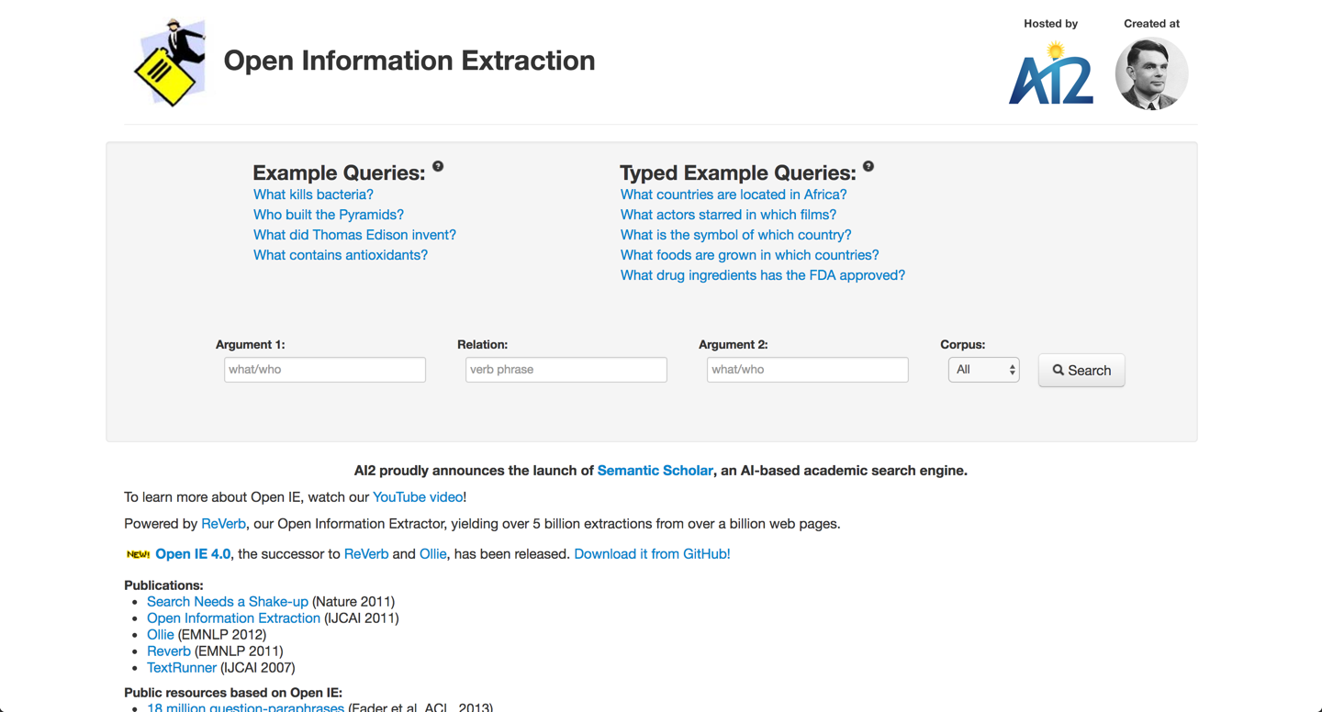
http://openie.allenai.org/
Kejriwal, Szekely

Slide 53
Practical IE Technologies
 | Glossary | Regex | NLP Rules | Semi- Structured | CRF | NER | Table
Effort | assemble glossary | hours | hours | minutes | O(1000) annotations | zero | O(10) annotations
Expertise | minimal | high, programmer | low | minimal | low-medium | zero | minimal
Precision | medium (ambiguity) | high | high | high | medium-high | medium-high | high
Recall | medium (formatting) | low f(# regex) | medium f(# rules) | high | medium | medium | high
Coverage | wide | wide | wide | single site | genre | genre | narrow
Kejriwal, Szekely

Slide 54
how to represent KGs?

Slide 55
KG Definition
a directed, labeled multi-relational graph representing facts/assertions as triples
(h, r, t) head entity, relation, tail entity
(s, p, o) subject, predicate, object

Slide 56
Simplest Knowledge Graph
Entities
LGYV
mentions
mentions
Legacy Ventures International Inc
mentions
Damn Good Penny Stocks

Slide 57
Simple, But Useful KG
Entities + properties (relation extraction)
LGYV
stock-ticker
company
Legacy Ventures International Inc
promoter
Damn Good Penny Stocks

Slide 58
Semantic Web KG (RDF/OWL)
Entities + properties + classes
LGYV
stock-ticker
Company
is-a
is-a
Legacy Ventures International Inc
promoter
Damn Good Penny Stocks

Slide 59
“Ideal” KG
Entities + properties + classes + qualifiers
LGYV
stock-ticker
Company
is-a
is-a
Legacy Ventures International Inc
promoter
Damn Good Penny Stocks
source
stockreads.com
start-date
June 2017

Slide 60
Semi-Structured KG Entities + properties + text + provenance + confidence

Slide 61
Where to Store KGs?

Slide 62
Serializing Knowledge Graphs
Resource Description Framework (RDF)
Database (triple store): AllegroGraph, Virtuoso,
Query: SPARQL (SQL-like)
Key-Value, Document Stores
Data model: Node-centric
Databases: Hbase, MongoDB, Elastic Search, …
Query: filters, keywords, aggregation (no joins)
Graph Databases
Data model: graph
Databases: Neo4J, Cayley, MarkLogic, GraphDB, Titan, OrientDB, Oracle, …
Query: GraphQL, Gremlin, Cypher
Notes:
Cover definitions, pros and cons

Slide 63
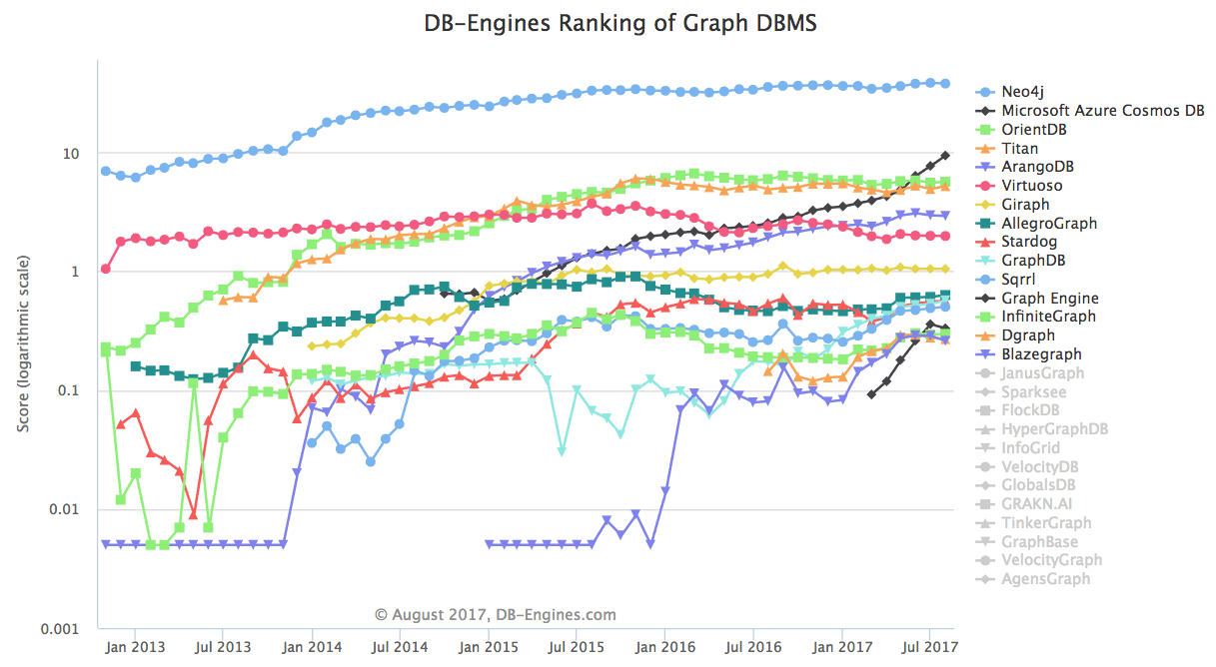
Popularity Ranking Of Graph Databases
https://db-engines.com/en/ranking_trend/graph+dbms

Slide 64
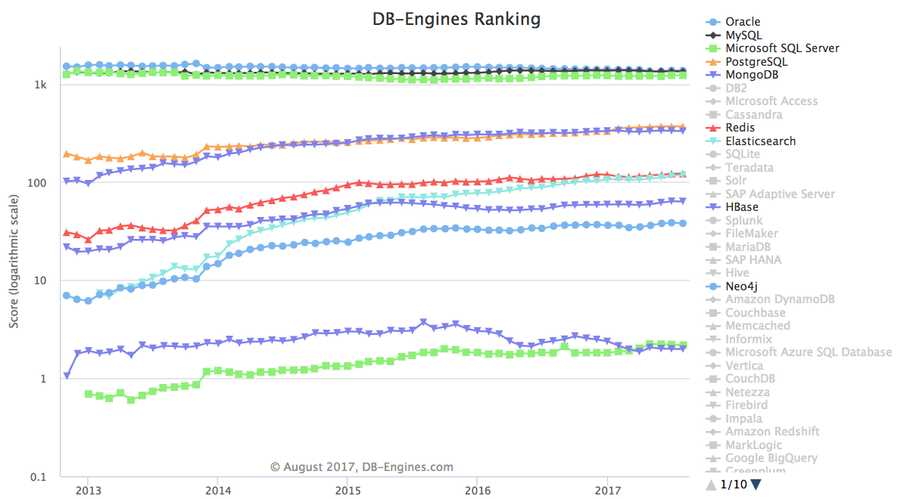
ElasticSearch, MongoDB & Neo4J Have Wide Adoption
Triple Stores
https://db-engines.com/en/ranking_trend/graph+dbms

Slide 65
KGs I can Reuse

Slide 66
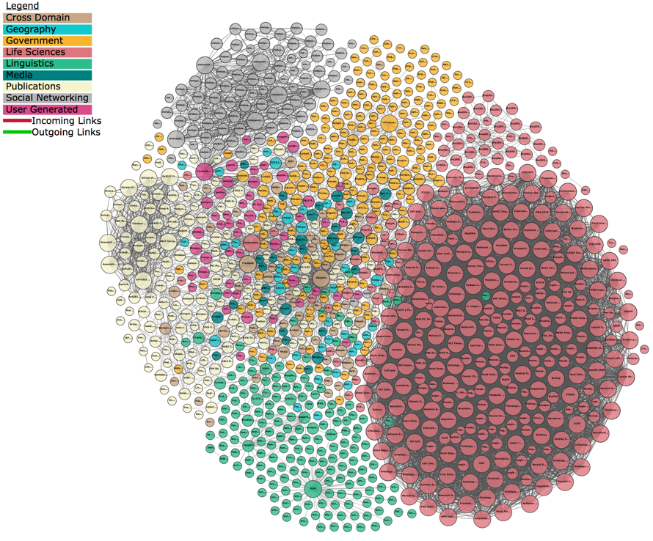
Linked
Open
Data
Cloud

Slide 67
DBpedia RDF graph derived from Wikipedia http://wiki.dbpedia.org/
4.58 million things
4.22 million are classified in a consistent ontology
1,445,000 persons
735,000 places
478,000 populated places),
411,000 creative works
123,000 music albums, 87,000 films and 19,000 video games
241,000 organizations
58,000 companies and 49,000 educational institutions
251,000 species
6,000 diseases
Notes:
Describe the highlights of each case study, with a particular emphasis on application

Slide 68
YAGO Knowledge Base http://www.mpi-inf.mpg.de/departments/databases-and-information-systems/research/yago-naga/yago/downloads
Derived from Wikipedia WordNet and GeoNames
10 million entities
120 million assertions persons, organizations, cities, etc.
350,000 classes
many fine grained classes, inferred from the data

Slide 69
Wikidata The ”wikipedia” of data https://www.wikidata.org/wiki/Wikidata:Main_Page
Collaborative, multilingual
collecting structured data to provide support for Wikipedia
31,419,072 items
534,615,360 edits since the project launch

Slide 70
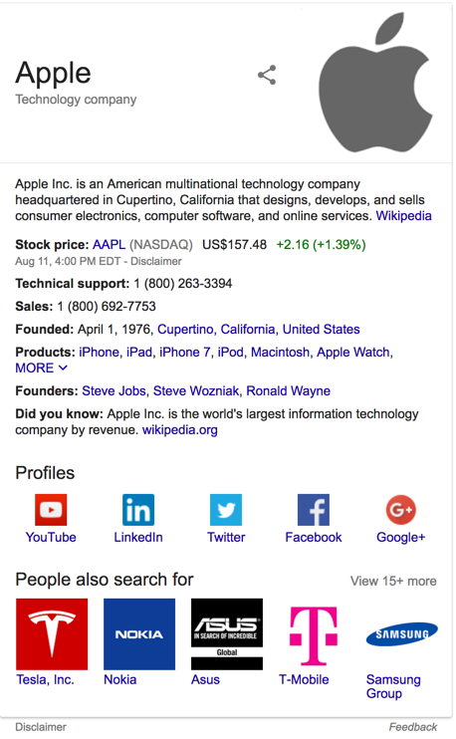
Google Knowledge Graph
https://developers.google.com/knowledge-graph/how-tos/search-widget-example
search: APPL
derived from many sources, including the CIA World Factbook, Wikidata, and Wikipedia
powers a "knowledge panel"
the Knowledge Graph now holds 70 billion facts

Slide 71
Other Knowledge Graphs
Internet Movie Firearms Database
Firearms used or featured in movies, television shows, video games, and anime
22,159 articles, extensive coverage and ontology
http://www.imfdb.org/wiki/Category:Gun
Microsoft Satori
Large knowledge graph similar to Google KG, e.g., 1.8 million bottles of wine
Many streaming channels of real-time data, e.g., bitcoin, transportation, …
https://www.satori.com/
LinkedIn Knowledge Graph
450M members, 190M historical job listings, 9M companies, 28K schools,
1.5K fields of study, 600+ degrees, 24K titles and 35K skills in 19 languages
https://engineering.linkedin.com/blog/2016/10/building-the-linkedin-knowledge-graph

Slide 72
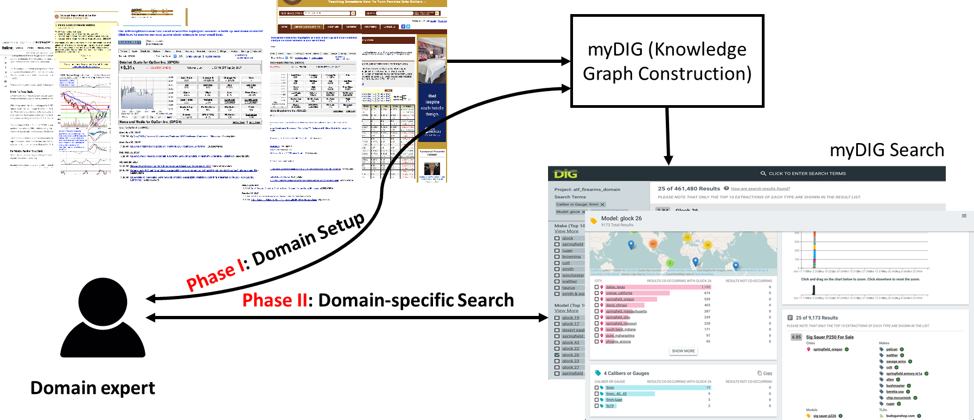
Beyond investigations: myDIG
myDIG requires no programming!
Have used it in a graduate class, master’s students used it for projects on cosmetics to soccer

Slide 73
Other use cases
Geopolitical Forecasting (IARPA HFC)
Providing forecasters with a research tool (DIG) that ingests pages from ACLED, PITF, Global Terrorism Database...
Causal Exploration (DARPA CauseEx)
Combine, visualize and search time series data, structured tables, unstructured text and webpages
Multi-modal Knowledge Graphs (DARPA AIDA)
Combine multi-modal extractions
Crisis Informatics (DARPA LORELEI)
Combine multi-lingual extractions
Academic Literature Mining
Pilot project for medical literature from PubMed
Many more
Smart/Open City
Scientific Data Analysis
Social Media

Slide 74
myDIG: A KG Construction Toolkit Python, MIT license, https://github.com/usc-isi-i2/dig-etl-engine
Enable end-users to construct domain-specific KGs
end users from 5 government orgs constructed KGs in less than one day
Suite of extraction techniques
semi-structured HTML pages, glossaries, NLP rules, NER, tables (coming soon)
KG includes provenance and confidences
enable research to improve extractions and KG quality
Scalable
runs on laptop (~100K docs), cluster (> 100M docs)
Robust
Deployed to many law enforcement agencies
Easy to install
Docker deployment with single “docker compose up” installation

Slide 75
Real-world Impact

Slide 76
In-use impact (sex trafficking)
100 million | escort ads
3 years | data coverage
2 billion | triples
100 | law enforcement offices
3 | convictions

Slide 77
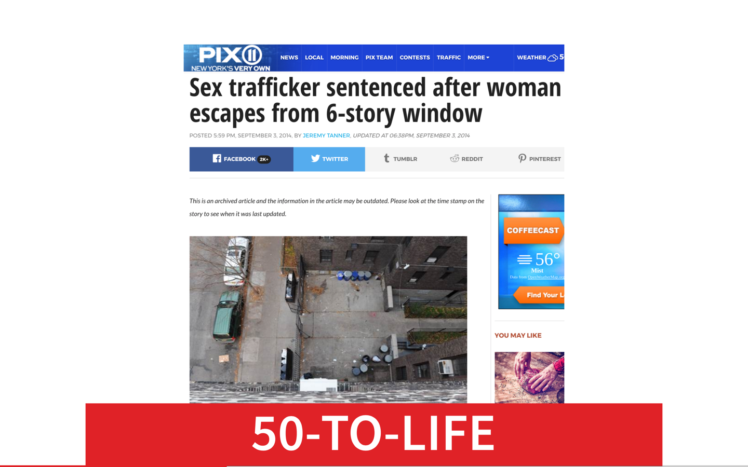
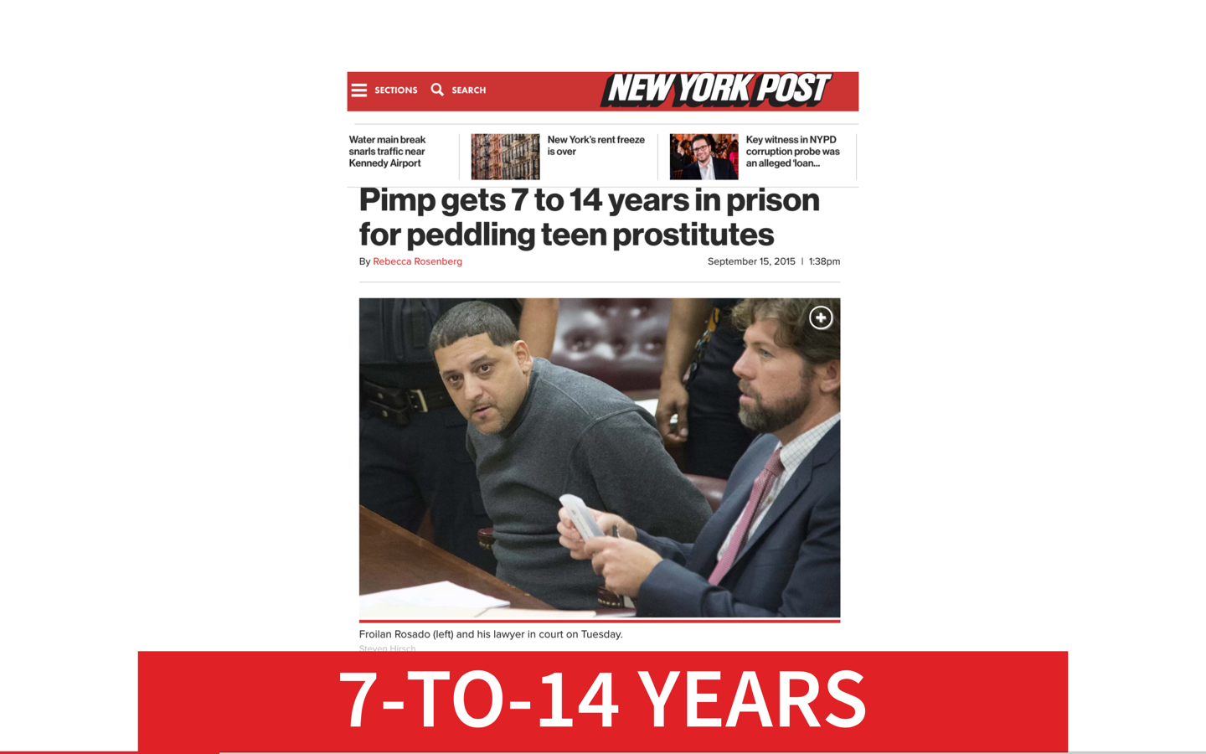
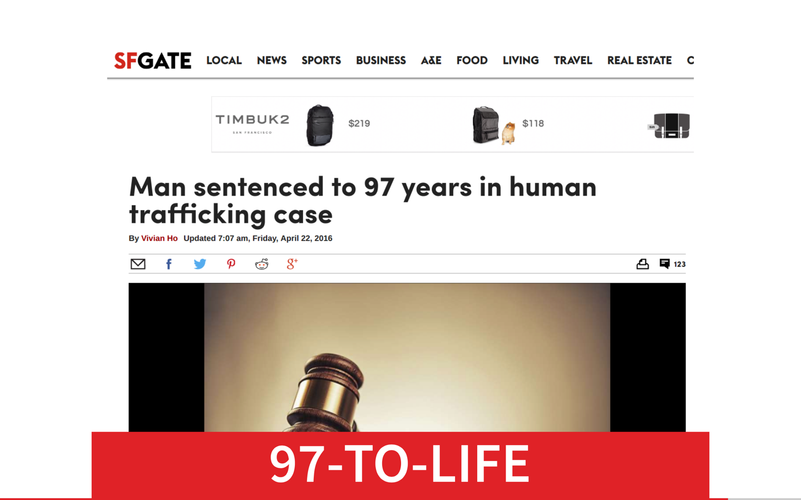
Prosecutions

Slide 78
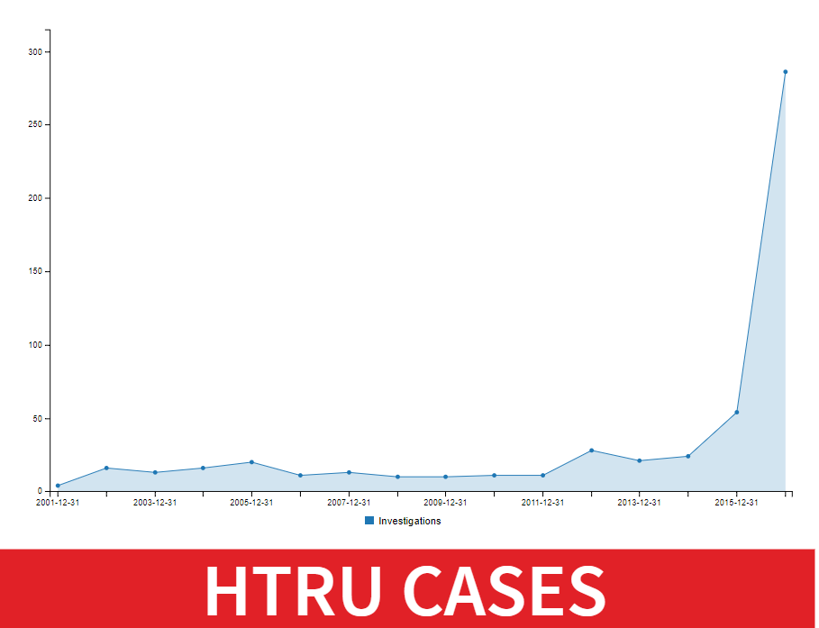
NY County District Attorney (HTRU)

Slide 79
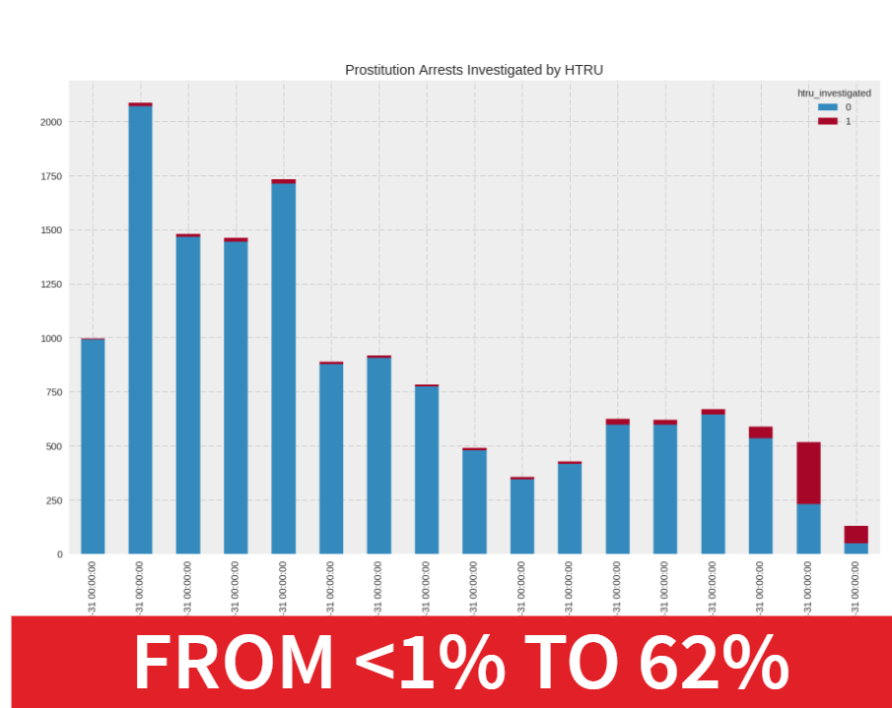

Slide 80
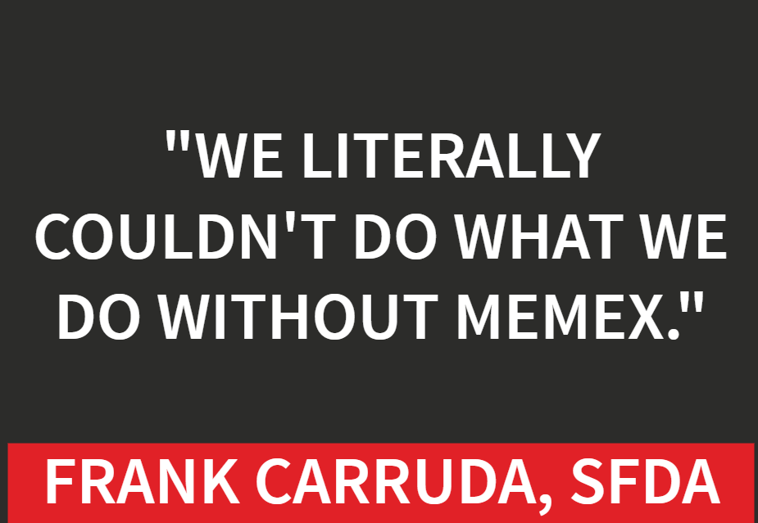
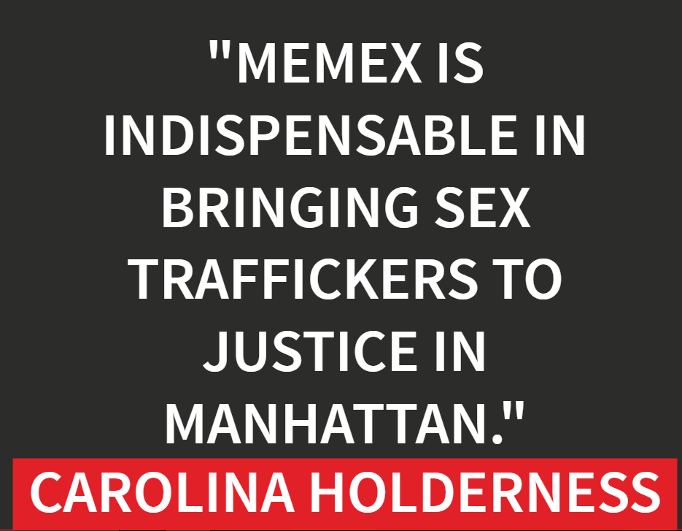

User Testimonials

Slide 81
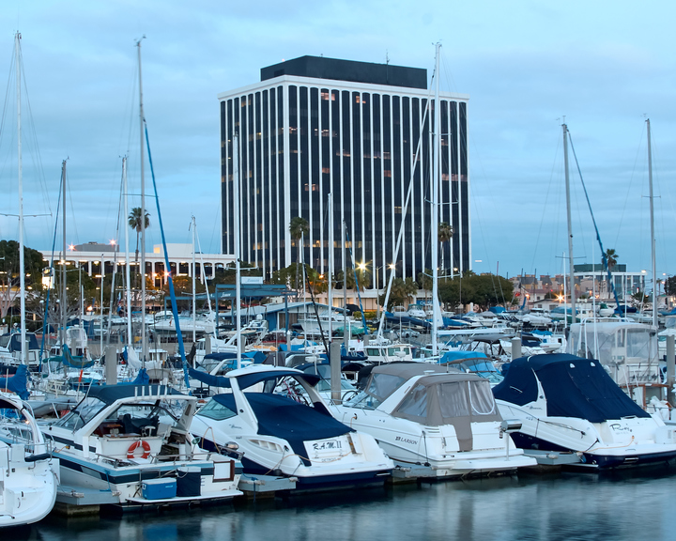


Thank you! Questions...
https://github.com/usc-isi-i2/dig-etl-engine

Slide 82
Querying Knowledge Graphs

Slide 83
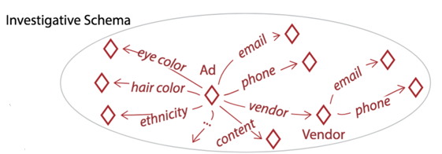
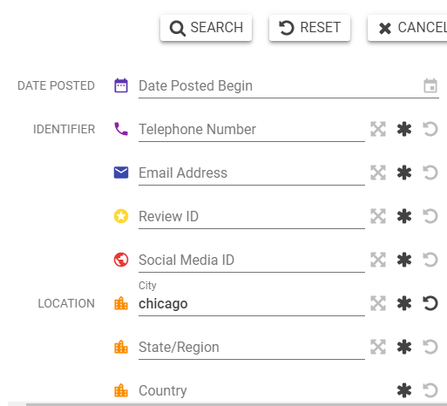
Knowledge Graph Query
What is the ethnicity listed in the ad that contains the phone number 6135019502, located in Toronto Ontario, with the title 'the millionaires mistress'?
SELECT ?ad ?ethnicity WHERE {
?ad a :Ad ;
:phone '6135019502' ;
:location 'Toronto, Ontario' ;
:title 'the millionaires mistress' ;
:ethnicity ?ethnicity . }

Slide 84
Why can’t I just ‘execute’ the query?
SELECT ?ad WHERE
{
?ad a :Ad ;
:hair_color 'Auburn' ;
:review_site_id 'cg9469f' ;
:price_per_hour '500' ;
:name 'Claire Gold' ;
:ethnicity ’Asian'.
}
NoSQL store
?

Slide 85
Many problems with ‘strict’ execution
synonyms “red”
typos “brunette”
SELECT ?ad WHERE
{
?ad a :Ad ;
:hair_color 'Auburn' ;
:review_site_id 'cg9469f' ;
:price_per_hour '500' ;
:name 'Claire Gold' ;
:ethnicity ’Asian'.
}
not present
numbers hard to match
Claire is a common name
Gold is a domain word
slang, e.g., “FOB” for Asian
inference, e.g., “Japanese”
NoSQL store
No results

Slide 86
Candidate Generation
Keyword expansion • Context broadening • Constraint relaxation
SELECT ?ad ?ethnicity WHERE
{
?ad a :Ad ;
:hair_color 'Auburn' ;
:review_site_id 'cg9469f' ;
:price_per_hour '500' ;
:name ’Claire Gold’ ;
:ethnicity ?ethnicity .
}
Precision
query 1
query 2
Query Reformulation
query 3
query 4
Recall
query n
Elastic Search
100M entities
Ranked
Candidates

Slide 87
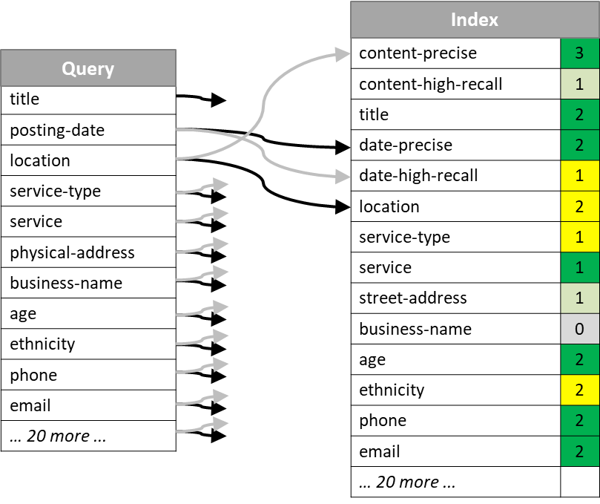
Offline step: Weighted Mapping Of Query To Index

Slide 88
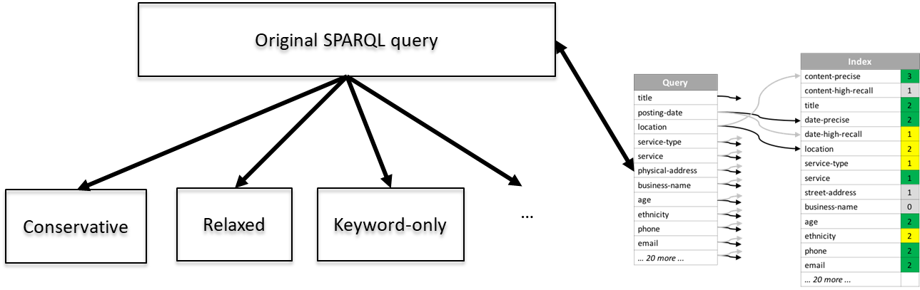
Online Step: Query reformulation using Semantic Strategies

Slide 89

Conservative Query

Slide 90

Relaxed Query

Slide 91

Keyword-only Query

Slide 92

Example of ‘Final’ Query

Slide 93

Example: query execution/ranking

Slide 94


Results

